Slide 1
Backing up on Dropbox your local data folders with Dropbox client
Notes:
[Mandatory Slide] This would be the introduction slide of the topic that you are covering in this subsection.
When this slide plays, you could talk about the main aim that we’d be covering in this video.

Slide 2
In this Video, we are going to take a look at…
Setup your Dropbox account
Setup the Dropbox Python SDK
Code sample
Notes:
[Mandatory Slide]
Before the start of the video, we’d like to highlight what are important topics or pointers that we’d be covering in this video. This slide would immediately follow the intro/name slide. This would just be say 2-3 points for the viewers to know what they are getting into.

Slide 3
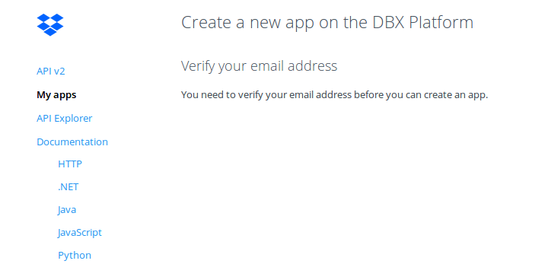

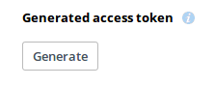
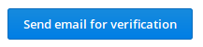
Setup your Dropbox account
If you don’t already have one, open up a new Dropbox account at https://dropbox.com
Go to https://dropbox.com/developers/apps, create a new App and hit “Send an email for verification”. Then click on the link that you’ve received in order to verify your identity
Choose to use the “Dropbox API”, then “Full Dropbox” as access type, then give a name to your app and create it. Take note of your App Key and App Secret
Generate an Access Token for your App and take note of it
Notes:
[Mandatory Slide]
Before the start of the video, we’d like to highlight what are important topics or pointers that we’d be covering in this video. This slide would immediately follow the intro/name slide. This would just be say 2-3 points for the viewers to know what they are getting into.

Slide 4
Setup the Dropbox Python SDK
Dropbox provides an easy to use API SDK. Install it with: pip install dropbox
Notes:
[Mandatory Slide]
Before the start of the video, we’d like to highlight what are important topics or pointers that we’d be covering in this video. This slide would immediately follow the intro/name slide. This would just be say 2-3 points for the viewers to know what they are getting into.

Slide 5
Code sample
Notes:
Something that needs to grab the viewers attention!!

Slide 6
Summary
Setup your Dropbox account
Setup the Dropbox Python SDK
Code sample
Notes:
[Mandatory Slide]
Before the start of the video, we’d like to highlight what are important topics or pointers that we’d be covering in this video. This slide would immediately follow the intro/name slide. This would just be say 2-3 points for the viewers to know what they are getting into.

Slide 7
Anatomy of a web application
Next Section
Notes:
[Mandatory Slide]
Here the name of the next section needs to be mentioned. The narration as you guessed it would be just letting the viewer know what we’d be taking over next! ☺

